Slide 1

Decoding Fabric Licensing
Kristyna Ferris
Fun Fact: this font is dyslexic friendly! Ask me how to use it for free after the session.
Notes:
Top 10 Dyslexia-Friendly Fonts for 2026 | TypeSmith | TypeSmith
Download the font from Atkinson Hyperlegible - Google Fonts
Extract the files
Go to computer settings > personalization > fonts and drop in the files
Navigate to Power Point Master Slide
Change the font to use Open Dyslexic for the headers and body
Done!

Slide 2

About Me ~ Kristyna Ferris
Microsoft MVP, Data Platform & Fabric
Solution Architect, P3 Adaptive
Lexington Data Tech Group co-organizer
DataOnWheels Author
Blog
https://dataonwheels.wordpress.com/
LinkedIn
https://www.linkedin.com/in/kristyna-ferris-dataonwheels/
Twitter & Bluesky
@data_dragoness

Slide 3
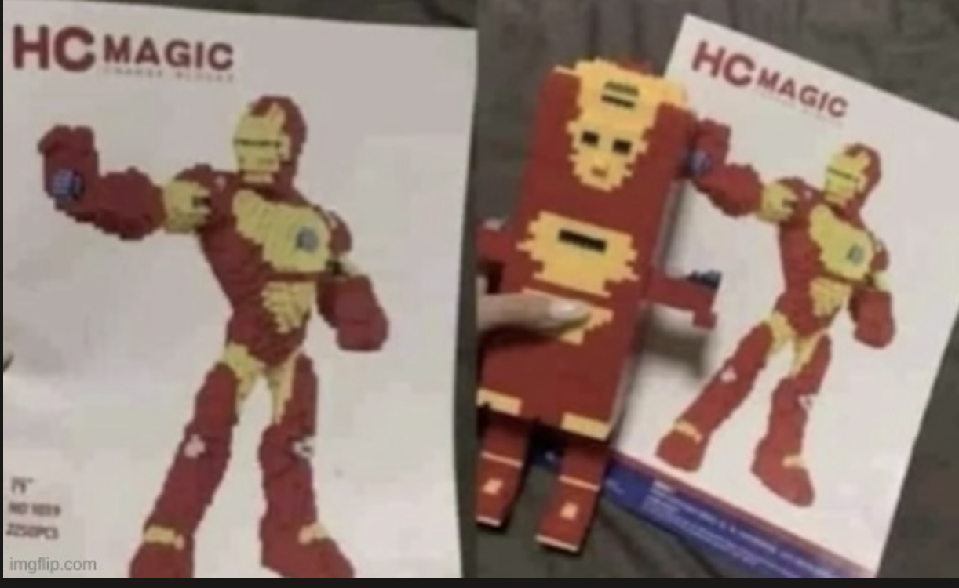
Welcome to Fabric Licensing sometimes the Microsoft Learn documents are not enough

Slide 4
Microsoft Fabric Licensing Key Concepts 1
Tenant
Microsoft Fabric is deployed to a Microsoft Entra tenant. Each tenant is tied to a specific Domain Name System (DNS) and other domains can be added to the tenant.
Capacity
Resides within a Fabric tenant. Each capacity that sits under a tenant is a distinct pool of resources allocated to Fabric. Size of the capacity determines the amount of computation power available. You can have multiple capacities per tenant. Each tenant has a default shared capacity that does not cost anything, but it cannot run Fabric items and items are not sharable.
Shared capacity runs on a server shared with other tenants.
Dedicated capacity runs on a server that only contains your tenant’s data (FSKUs).
Workspaces
Resides within capacities. Used as containers for Microsoft Fabric items. Each user has a personal workspace called “My Workspace”. More workspaces can be created to enable collaboration. You can have multiple workspaces in a capacity.
Notes:
Microsoft Fabric concepts - Microsoft Fabric | Microsoft Learn
Your Ultimate Guide to Microsoft Fabric Pricing and Licensing
Power BI Premium Per User - Power BI | Microsoft Learn
What Is a Microsoft Tenant? Tenant Core Concepts Explained

Slide 5
Microsoft Fabric Licensing Key Concepts 2
Stock Keeping Units (SKU)
Provides a set of Fabric resources for your organization.
Individual User Licensing
Licenses that are applied to individuals such as Power BI Pro and Power BI Premium Per User. These two licenses are purchased through Microsoft 365 portal.
Pay-As-You-Go Pricing
Fabric SKUs (FSKUs) that are purchased as needed. Can be set up to automatically scale up and down based on need and can be easily paused to save money when not in use. Ideal for work loads that do not need to run all the time and have highly variable consumption.
Reserved Pricing
FSKUs that are purchased at least a year in advance for a 40% pricing discount. Ideal for work loads that require continuous up time.
Notes:
Microsoft Fabric concepts - Microsoft Fabric | Microsoft Learn
Your Ultimate Guide to Microsoft Fabric Pricing and Licensing
Power BI Premium Per User - Power BI | Microsoft Learn

Slide 6













The Airport
The Airport - Tenant
Main Terminal - Shared Capacity
Private Terminal - Dedicated Capacity
Power BI & Dataflow Gen1 Only
Fabric Artifacts
Carry-On Bag - Personal Workspace
Fabric Workspace
Your bag, your stuff. Only you use it.
Airline Lounge - Pro Workspace
Lakehouse
SQL
Pipeline
Report
Everyone inside needs their own membership.
Day Pass - PPU Workspace
Warehouse
Dataflow
Notebook
Activator
Temporary access. Every person needs a pass.

Slide 7

Upgrade Level 1: Sharing + Publishing
Power BI Pro
LOUNGE MEMBERSHIP
Cost - $14/month/user
Power BI Pro License
Purchase Location - M365, is also included with an E5 license
Your ticket out of the main terminal.
Without this, you're stuck at your
own gate (Personal Workspace).
Everyone in the lounge needs
their own membership card.
Enables
Publishing Power BI reports to a shared workspace
Access to shared capacity workspaces that are not PPU workspaces

Slide 8


Upgrade Level 2: Premium PBI Features
Premium Per User
FIRST CLASS LOUNGE
Cost - $24/month/user
Premium Per User License
Purchase Location - M365
The premium lounge with bigger seats,
faster Wi-Fi, and better food.
Larger models, more frequent
refreshes, XMLA endpoints,
and advanced dataflow features.
Everyone in the first class lounge
needs their own PPU pass.
Enables
Publishing Power BI reports to a shared workspace
Access to shared capacity workspaces
Larger model sizes
More frequent refreshes
XMLA endpoint connectivity
Advanced dataflow features
Incremental refresh

Slide 9


Upgrade Level 3: Capacity to do More
Fabric Capacity
PRIVATE TERMINAL
Cost - depends on SKU and reserved pricing/pay-as-you-go
Fabric Capacity (F SKU)
Your own terminal. Your own runway.
No sharing with other airlines.
Full access to all Fabric artifacts.
Size of the terminal (SKU) determines
how much traffic you can handle.
F64+ terminal: passengers (viewers)
don't need their own lounge pass.
Purchase Location - Azure portal. Requires an Azure subscription and resource group.
Enables
Fabric artifacts
>= F64 SKU enables free viewers
Copilot (any SKU!)
Managed private endpoints
On-demand resizing, pause & resume capacity
Trusted workspace access

Slide 10
Fabric Capacity Pricing
Pay-as-you-go
Reservation
Pausing and auto-scaling capacity
Can be combined with a reservation to allow for auto-scaling when needed
More expensive per hour but may be cheaper if paused
Breaks even in cost with reserved at < 14 hours a day
41% discount
Does not scale up/down nor pause
Reservation is cheaper because you sign a year long contract for a set number of SKUs
These SKUs can be split into multiple capacities if desired
Notes:
Microsoft Fabric - Pricing | Microsoft Azure
Breakeven points:
F64 = 358 pro licenses = 209 ppu licenses
730 hours FSKU reserved (a month) = 434 hours FSKU pay-as-you-go (18 days)
If you only need capacity for <14 hours a day, pay-as you-go is the best option

Slide 11
Breakeven Points
Reserved versus pay-as-you-go
F64 Compared to Power BI
730 hours FSKU reserved
(a month)
=
434 hours FSKU pay-as-you-go
(18 days)
F64
=
358 pro licenses
=
209 ppu licenses
Notes:
Microsoft Fabric - Pricing | Microsoft Azure
Breakeven points:
F64 = 358 pro licenses = 209 ppu licenses
730 hours FSKU reserved (a month) = 434 hours FSKU pay-as-you-go (18 days)
If you only need capacity for <14 hours a day, pay-as you-go is the best option

Slide 12
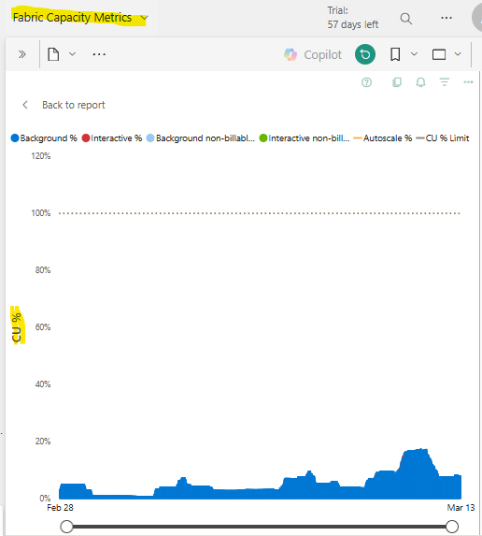
Picking out a Fabric SKU
Use a Fabric Trial!
60 days of free F64 usage
Aim for maximum 80% of capacity
Multiple developers? Min rec SKU is F8
Multiple data sources to ingest? Min rec SKU is F16
A lot of report viewers? Consider a F64 for free viewer licensing (discussed more in upcoming slides)
Environment concerns? Use diff capacities for dev, test, prod
Notes:
Install the Microsoft Fabric capacity metrics app - Microsoft Fabric | Microsoft Learn
F8 allows for multiple spark sessions at a time for notebooks. This allows more than one developer to be working in a notebook at once.
F16 has proven to be a good SKU for ingesting multiple data sources into Fabric using a metadata driven approach.
F64 unlocks more capabilities, but those are not unlocked with a F64 reservation, only with a F64 capacity.

Slide 13
How Do Reservations Work?
Reservation Scenario 1
F64 split
Annual contract with Microsoft for a 41% discount on F SKUs.
Can be paid monthly or upfront.
These SKUs can be split into multiple capacities or all used within one capacity.
You pay for all the SKUs even if they are not assigned to a capacity, so it is best to use them all.
You can get cancel, exchange, or refund reservations with certain limitations
Capacity 1 | F16
Capacity 3 | F32
Capacity 2 | F16
Reservation Scenario 2
F64 one capacity
Capacity 1 | F64*
* These workspaces get the benefits of an F64 capacity (Copilot, free license viewing, and AI skills)
Notes:
https://learn.microsoft.com/en-us/azure/cost-management-billing/reservations/fabric-capacity#cancel-exchange-or-refund-reservations

Slide 14
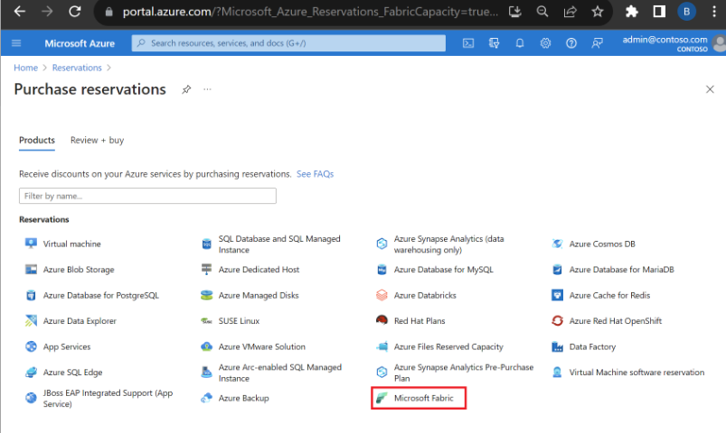
How-To Purchase Capacity Reservation
portal.azure.com > Reservations > Microsoft Fabric
Prerequisites
Azure Subscription (method for paying)
Azure Resource Group (tool for grouping your Azure resources)
Must have owner role or reservation purchaser role on an Azure subscription
Notes:
Save costs with Microsoft Fabric Capacity reservations - Microsoft Cost Management | Microsoft Learn
For Enterprise subscriptions, the Reserved Instances policy option must be enabled in the Azure portal. If the setting is disabled, you must be an EA Admin to enable it.
Direct Enterprise customers can update the Reserved Instances policy settings in the Azure portal. Navigate to the Policies menu to change settings.
For the Cloud Solution Provider (CSP) program, only the admin agents or sales agents can purchase Fabric capacity reservations.
https://learn.microsoft.com/en-us/azure/cost-management-billing/reservations/fabric-capacity#cancel-exchange-or-refund-reservations

Slide 15

What’s the Right Option for You?

Slide 16

What’s the Right Option for You?

Slide 17



Licensing Scenario Personas & Workspace Types
Data Engineers
PBI Developers
Report Viewers
Ground Crew & Mechanics
Create Fabric artifacts
(lakehouses, warehouses, notebooks, data pipelines, etc.)
Pilots
Create Power BI semantic models
Create Power BI reports
** Publish reports to shared workspaces
Passengers
*** Utilize Power BI reports to answer business questions
** Requires either a pro or ppu license
*** Requires a pro license if in a shared workspace, ppu license if in a ppu workspace, and no license if in a F64 capacity workspace
Notes:
Microsoft Fabric concepts - Microsoft Fabric | Microsoft Learn
Pro workspaces allow for 10 GB size datasets, only 8 refreshes a day.
PPU workspaces allow for 100 GB size datasets, 48 refreshes a day, advanced dataflow features, deployment pipelines, xmla connectivity, page refresh, incremental refresh.

Slide 18
Licensing Example 1
No ETL, Small User Base
Assumptions
0 Fabric Data Engineers
  Engineering is handled outside Fabric
2 Power BI Developers
50 Report Viewers
X 0 = $0
X 2 x $14/pro license = $ 28
X 50 x $14/pro license = $700
Total Monthly Estimate: $728
Total Annual Estimate: $8,736
+ External Engineering Costs
Notes:
Microsoft Fabric concepts - Microsoft Fabric | Microsoft Learn
Power BI Premium Per User - Power BI | Microsoft Learn
Pro workspaces allow for 10 GB size datasets, only 8 refreshes a day. Breaks even with F64 at 358 users.
PPU workspaces allow for 100 GB size datasets, 48 refreshes a day, advanced dataflow features, deployment pipelines, xmla connectivity, page refresh, incremental refresh. Breaks even with F64 at 209 users.

Slide 19
Licensing Example 2
No ETL, Small User Base, PPU Workspaces Needed
Assumptions
0 Fabric Data Engineers
  Engineering is handled outside Fabric
2 Power BI Developers
50 Report Viewers
X 0 = $0
X 2 x $24/ppu license = $48
X 50 x $24/ppu license = $1,200
Total Monthly Estimate: $1,248
Total Annual Estimate: $14,976
+ External Engineering Costs
Notes:
Microsoft Fabric concepts - Microsoft Fabric | Microsoft Learn
Power BI Premium Per User - Power BI | Microsoft Learn
Pro workspaces allow for 10 GB size datasets, only 8 refreshes a day. Breaks even with F64 at 358 users.
PPU workspaces allow for 100 GB size datasets, 48 refreshes a day, advanced dataflow features, deployment pipelines, xmla connectivity, page refresh, incremental refresh. Breaks even with F64 at 209 users.

Slide 20
Licensing Example 3
No ETL, Large User Base
Assumptions
0 Fabric Data Engineers
  Engineering is handled outside Fabric
5 Power BI Developers
∞ Report Viewers
Reserved F64 pricing
X 0 = $0
X 5 x $14/pro license = $70
F64 = $5,000
X ∞ x $0 viewer = $0
Total Monthly Estimate: $5,070
Total Annual Estimate: $60,840
+ External Engineering Costs
Notes:
Microsoft Fabric concepts - Microsoft Fabric | Microsoft Learn
Power BI Premium Per User - Power BI | Microsoft Learn
Pro workspaces allow for 10 GB size datasets, only 8 refreshes a day. Breaks even with F64 at 358 users.
PPU workspaces allow for 100 GB size datasets, 48 refreshes a day, advanced dataflow features, deployment pipelines, xmla connectivity, page refresh, incremental refresh. Breaks even with F64 at 209 users.

Slide 21
Licensing Example 4
Small ETL, Small User Base
Assumptions
2 Fabric Data Engineers
  Going with F16 for the estimate
  Using reserved pricing
2 Power BI Developers
50 Report Viewers
F16 = $1,250
X 2 x $14/pro license = $28
X 50 x $14/pro license = $700
Total Monthly Estimate: $1,978
Total Annual Estimate: $23,736
Notes:
Microsoft Fabric concepts - Microsoft Fabric | Microsoft Learn
Power BI Premium Per User - Power BI | Microsoft Learn
Pro workspaces allow for 10 GB size datasets, only 8 refreshes a day.
PPU workspaces allow for 100 GB size datasets, 48 refreshes a day, advanced dataflow features, deployment pipelines, xmla connectivity, page refresh, incremental refresh.
Until F64, all viewers need a pro license to view

Slide 22
Licensing Example 5
Larger ETL, Small User Base
Assumptions
2 Fabric Data Engineers
  Going with F32 for the estimate
  Using reserved pricing
2 Power BI Developers
50 Report Viewers
F32 = $2,501
X 2 x $14/pro license = $28
X 50 x $10/pro license = $700
Total Monthly Estimate: $3,229
Total Annual Estimate: $38,748
Notes:
Microsoft Fabric concepts - Microsoft Fabric | Microsoft Learn
Power BI Premium Per User - Power BI | Microsoft Learn
Pro workspaces allow for 10 GB size datasets, only 8 refreshes a day.
PPU workspaces allow for 100 GB size datasets, 48 refreshes a day, advanced dataflow features, deployment pipelines, xmla connectivity, page refresh, incremental refresh.
Until F64, all viewers need a pro license to view

Slide 23
Licensing Example 6
Larger ETL, Large User Base
Assumptions
10 Fabric Data Engineers
  Going with F64 for the estimate
  Using reserved pricing
5 Power BI Developers
∞ Report Viewers
F64 = $5,000
X 5 x $14/pro license = $70
X ∞ x $0 viewer license = $0
Total Monthly Estimate: $5,070
Total Annual Estimate: $60,840
Notes:
Microsoft Fabric concepts - Microsoft Fabric | Microsoft Learn
Power BI Premium Per User - Power BI | Microsoft Learn
Pro workspaces allow for 10 GB size datasets, only 8 refreshes a day.
PPU workspaces allow for 100 GB size datasets, 48 refreshes a day, advanced dataflow features, deployment pipelines, xmla connectivity, page refresh, incremental refresh.
Until F64, all viewers need a pro license to view

Slide 24

Helpful Additional Tools
https://data-witches.com/power-bi-licensing-calculator/
Microsoft Fabric Licensing: An Ultimate Guide – RADACAD
https://www.tigeranalytics.com/perspectives/blog/a-comprehensive-guide-to-pricing-and-licensing-on-microsoft-fabric/

Slide 25

Questions?

Slide 26

Don’t forget to connect, thanks for listening!
https://dataonwheels.wordpress.com/
kristyna@dataonwheels.com
@data_dragoness
GitHub

